Slide 1
Two Day Seminar on GST Demands & Appellate Remedies Topic: Filing of Appeals Date: 1st June 2024 (11:45AM to 1:15 PM) By CA. N K Bharath Kumar
SIRC of ICAI

Slide 2
Demands & Remedies
Demands Under GST
ASMT-10
DRC - 01 A
DRC – 01
DRC – 07
MOV – 09
Appellate Remedies (after adjudication)
First Appellate Authority
Second Appellate Authority
High Court
Supreme Court

Slide 3
FILING OF APPEALS

Slide 4
How do we file an appeal against Demand Order?

Slide 5
Things to Keep ready 1. DRC – 07 2. Detailed / Speaking Order 3. Show Cause Notice 4. Reply to SCN 5. Proof of Receipt of Order 6. Workings, Calculations, Annexures, Case Laws

Slide 6
To file an appeal against a demand order, perform following steps
STEP 1:
Access the www.gst.gov.in. The GST Home page is displayed & Login to the GST Portal with valid credentials i.e. your User Id and Password.

Slide 7
Creating Appeal to Appellate Authority
STEP 2:
Click the Services > User Services > My Applications command

Slide 8
STEP 3: The My Applications page is displayed. Select the Application Type as Appeal to Appellate Authority from the drop-down list.
1
STEP 4: Click the NEW APPLICATION button.
2
STEP 5: The GST APL-01: Appeal to Appellate Authority page is displayed.
3

Slide 9
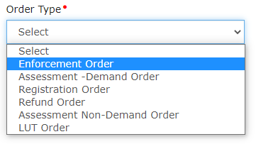
6. Select the option Yes if the order pertaining to Multiple Financial Years or No to proceed with single Financial Year. Select the Order Type from the drop-down list.
Note 1: Multiple Financial Years is applicable for Form GST DRC-07 and Form GST DRC-08 Orders. Now, the appeals can be filed for Multiple Financial Years basis the DRC 07 or DRC 08 order under the Assessment demand or Enforcement demand category.
Note 2: If you select option Yes, then the following options will be displayed in the drop-down list.
Note 3: If you select option No, then the following options will be displayed in the Order Type drop-down list

Slide 10
7. In the Order Type field, enter the Order Number issued by adjudicating authority.
8. Click the SEARCH button.

Slide 11
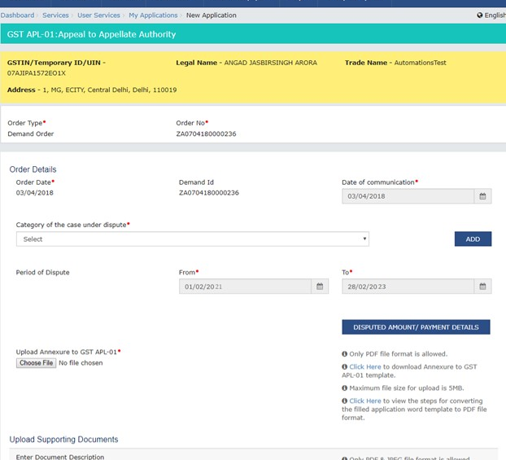
9. The Order Details page is displayed.
Note: If rectification is already filed, Appeal cannot be filed. However, after Rectification request is completed, Appeal can be filed only for the said Rectified order, but not against the original order.

Slide 12
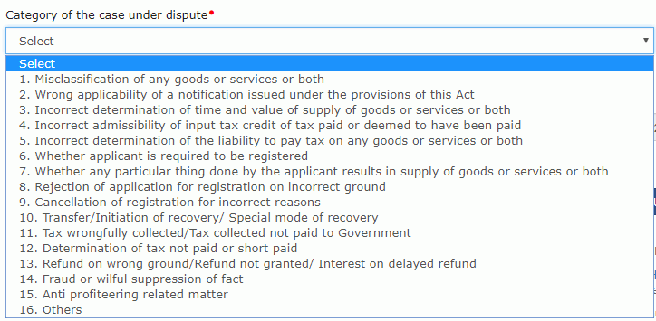
10. Select the Category of the case under dispute from the drop-down list.

Slide 13
11. Click the ADD button
Note:
1. Date of Communication and Period of Dispute is displayed on the screen. However, you can edit the same.
2. You can add multiple line items from the Category of the case under dispute drop-down list by clicking the ADD button.
3. You can click the DELETE button to delete the details added.

Slide 14
Points to be noted 1. Valid service of Order - DRC – 07 – Sec. 169 2. Detailed / Speaking Order – Is it ? 3. Proof of Receipt of Order – How? 4. Opportunity of Rectification – Sec. 161

Slide 15
Upload Annexure to GST APL-01
12. Click the click here link to download the Annexure to GST APL-01 Template.

Slide 16
14. Click the Enable Editing button.

Slide 17
Enter the details. 14 & 15???

Slide 18
21. Click the Choose File button to upload the PDF.

Slide 19
22. Select the PDF file which was saved and click the Open button.

Slide 20
23. The PDF file is uploaded. You can click the DELETE button to delete the uploaded PDF file.

Slide 21
C. Disputed Amount/ Payment Details
24. Click the DISPUTED AMOUNT/PAYMENT DETAILS button to enter disputed amount and payment details.

Slide 22
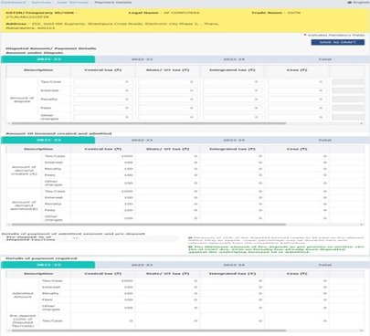
25. The Disputed Amount/ Payment Details page is displayed. Note: If you have selected the option Yes for order pertaining to Multiple Financial Years then, the Disputed Amount/Payment page for Multiple Financial years will be displayed in separate tabs for each Financial Year.

Slide 23
26 (a). In the Amount under Dispute section, enter the amount which is under dispute. Amount under Dispute cannot be more than Amount of Demand Created.
Note 1: • Overall tax period will be auto-populated from Original order and cannot be changed while filing Appeal.
• For multiple Financial Years, you have to select each year and then enter the amount which is under dispute.
• Pre-deposit amount is calculated for total amount and will be auto-populated for all Financial Years, based on the disputed amount entered

Slide 24
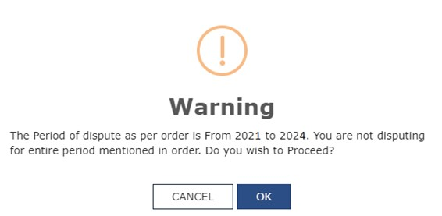
Note 2: • If you have not disputed any component of the demand in any Financial Year, then default value Zero will be mentioned in that Financial Year. • If a demand is not entered in a Financial Year or if the number of years disputed in application is less than the number of years in the original order, then a Warning message will be displayed.

Slide 25
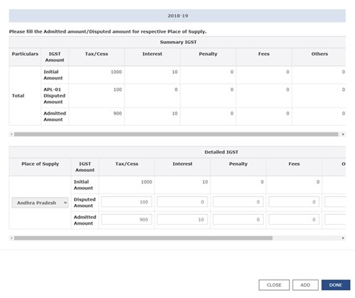
Note 3: If you have selected IGST, then fill the Admitted amount/Disputed amount for respective Place of Supply. Click the DONE button. Click the ADD button to enter IGST amount corresponding to the respective Place of Supply.

Slide 26
26 (b). Use the scroll bar to view the Total Amount under dispute.

Slide 27
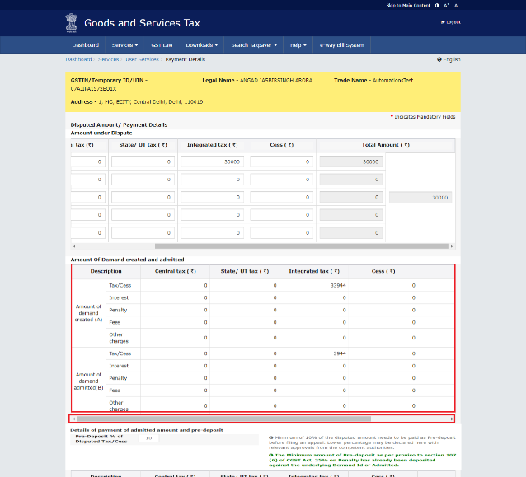
27 (a). Amount of Demand created and admitted is displayed in this section

Slide 28
27 (b). Use the scroll bar to view the Total Amount of Demand created and admitted.

Slide 29
D. Pre-deposit % of disputed tax
Note:
1. Pre-deposit % of disputed tax field will have 10% as default value. Minimum of 10% of the disputed amount needs to be paid as pre-deposit before filing an appeal. Lower percentage can be given here, if the same has been approved by the competent authorities.
Based on the percentage entered details of payment required, details of payment of admitted amount and pre-deposit and details of amount payable towards admitted amount and pre-deposit sections are auto-populated.
2. When the taxpayer is submitting an Appeal against MOV 09 / rectified MOV 09 and has already paid minimum of 25% of penalty amount mentioned in original order, he/she need not pay the pre-deposit 25% additionally on such penalty component while filing appeal.

Slide 30
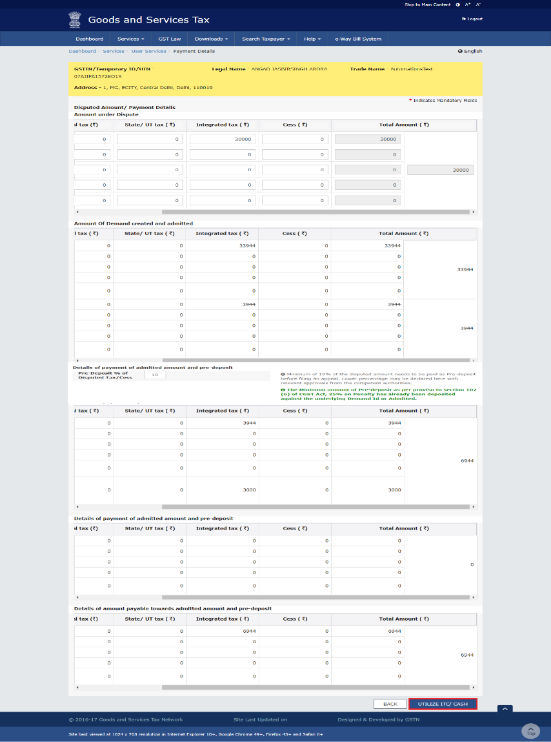
E. Utilize Cash/ ITC
30. Click the UTILIZE ITC/CASH button.
Note: If sufficient amount necessary has already been remitted against the appeal application and amount payable is appearing 0, yet a taxpayer clicks on UTILIZE ITC/ CASH button, then following message will be displayed on the screen.

Slide 31
Points to be noted 1. Pre-Deposit can be paid through ITC. 2. In case of payment under wrong head - use PMT-09 to transfer 3. Pre-Deposit can be made Zero and appeal can be filed* 4. Do not forget to claim interest @ 9% when refund is applied 5. Sometimes the order may have the demand but DRC-07 may not.

Slide 32
31. Liability, Cash Ledger Balance and Credit Ledger Balance details are displayed.

Slide 33
32 (a) Liability The liability as on date are shown in below table.

Slide 34
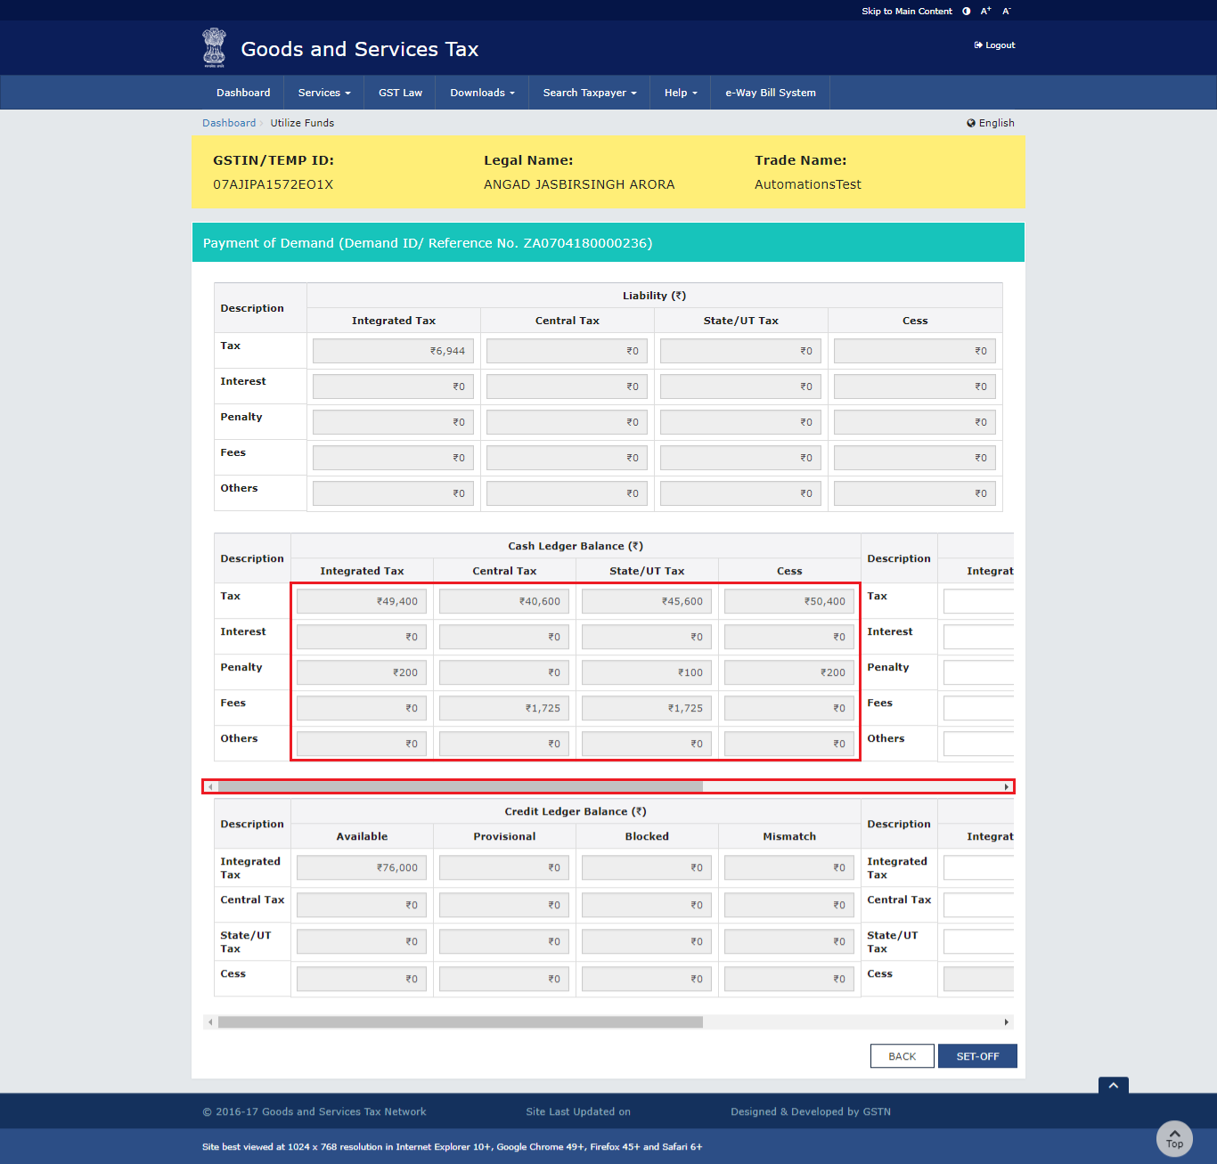
32 (b) Cash Ledger Balance The cash available as on date are shown in below table.

Slide 35
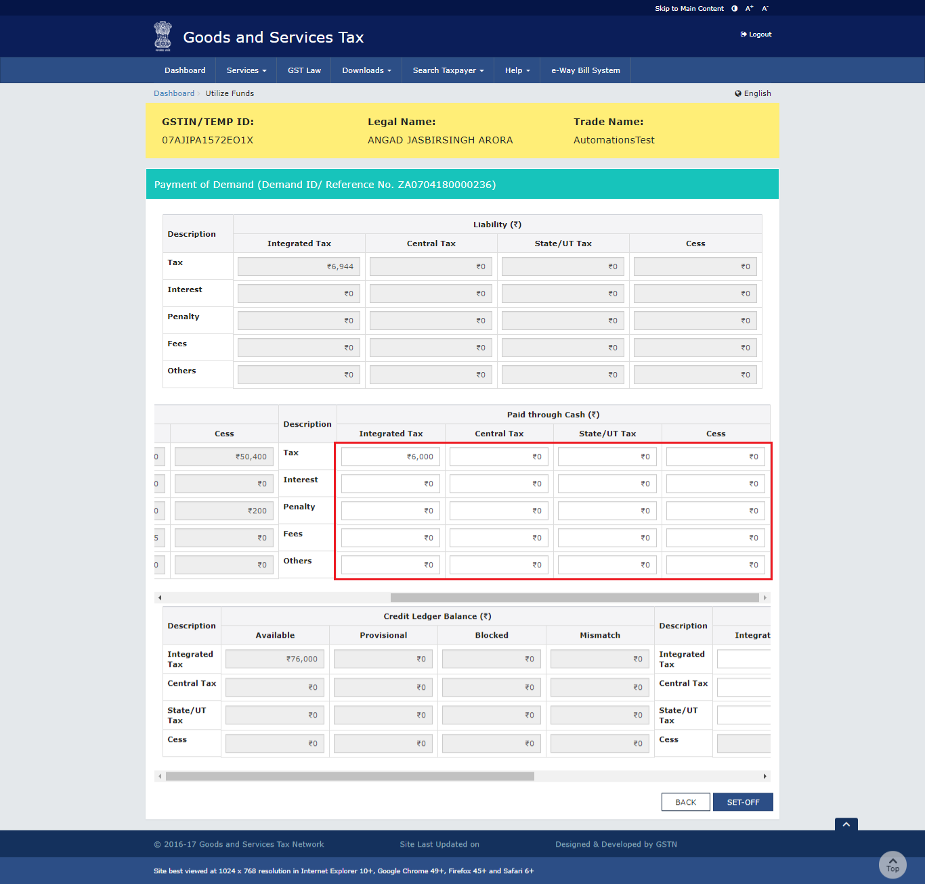
32 (c) Paid through Cash Use the scroll bar to move to the right to enter the amount to be paid through cash against that liability.

Slide 36
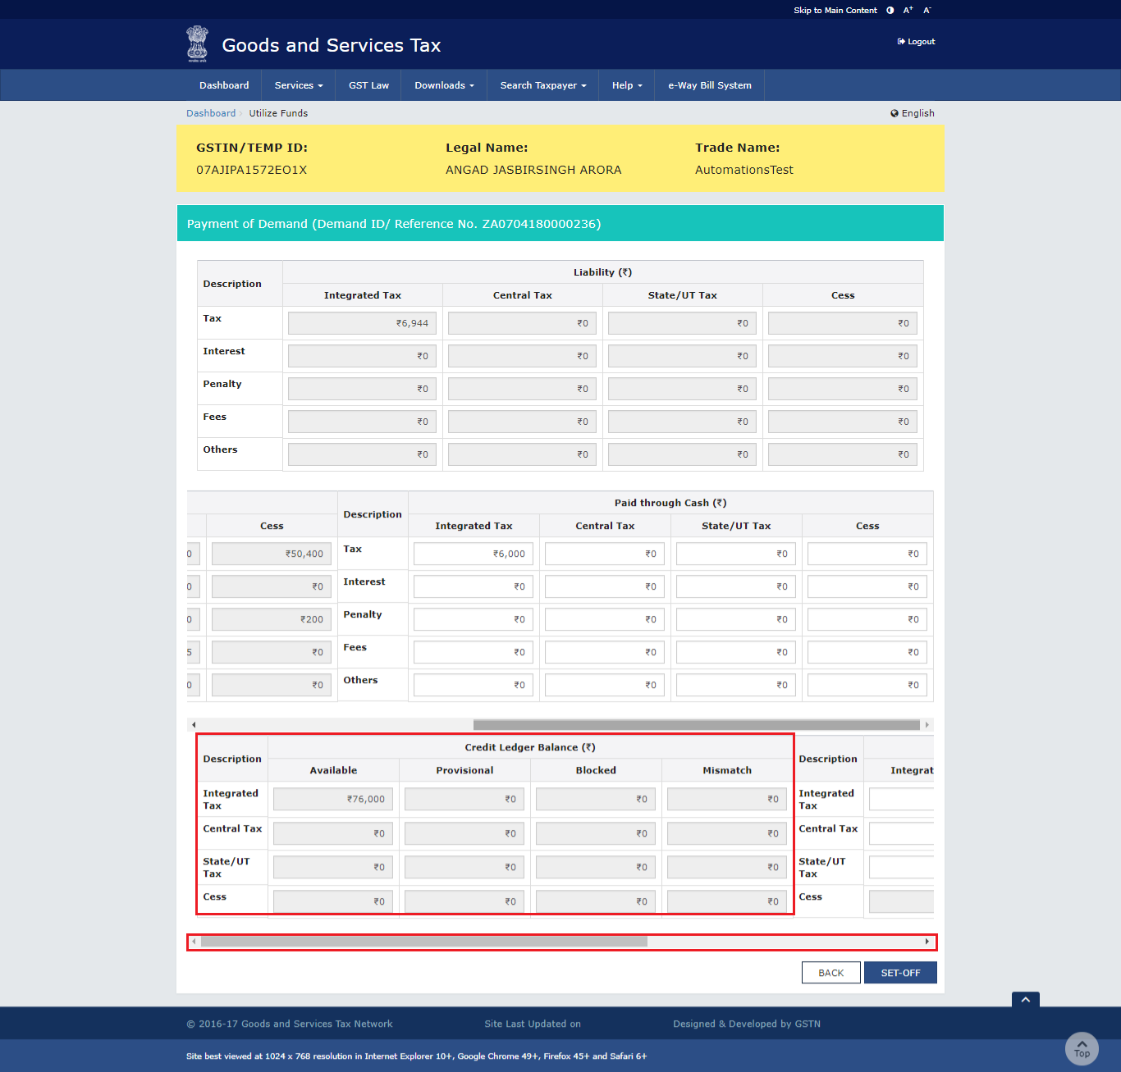
32 (d) Credit Ledger Balance The ITC available as on date are shown in below table.

Slide 37
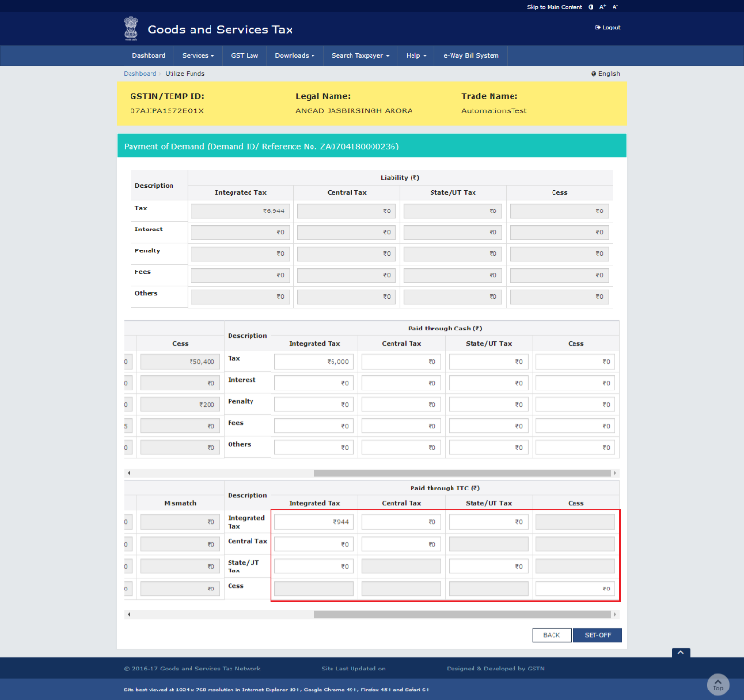
32 (e) Paid through ITC Use the scroll bar to move to the right to enter the amount to be paid through ITC against that liability. Note: ITC can be adjusted against Tax liability only.

Slide 38
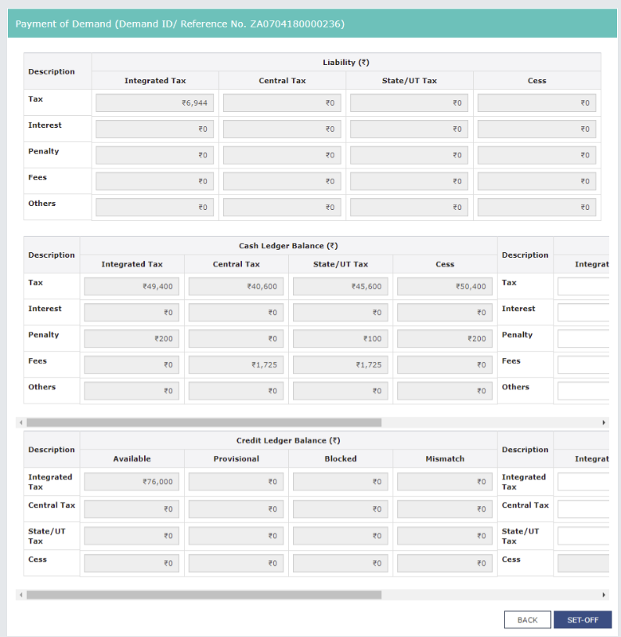
33. Once you have entered the amount, click the SET-OFF button.

Slide 39
34. A confirmation message is displayed. Click the OK button.

Slide 40
35. A success message is displayed. Payment Reference Number is displayed on the screen. Click the BACK button.

Slide 41
F. Add any Other Supporting Document
36. To upload any other supporting document, enter the document description and click the Choose File button.
Note:
Only PDF & JPEG file format is allowed.
Maximum file size for upload is 5MB.
Maximum 4 supporting documents can be attached in the application. The remaining documents can be handed over in hard copy

Slide 42
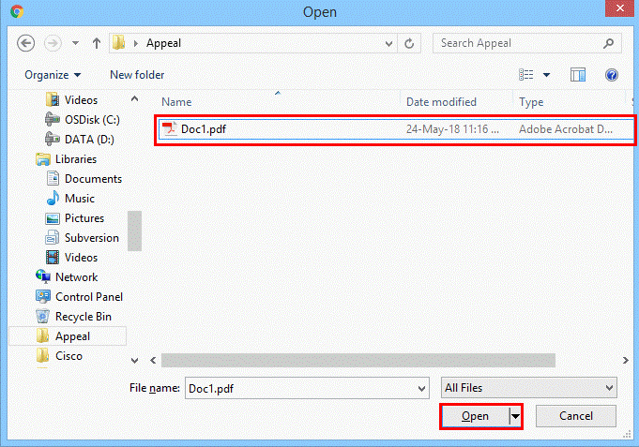
37. Select the file to be uploaded and click the Open button.

Slide 43
38. Click the ADD DOCUMENT button to add the uploaded supporting document.

Slide 44
39. The PDF file is uploaded. You can click the DELETE button to delete the uploaded PDF file.

Slide 45
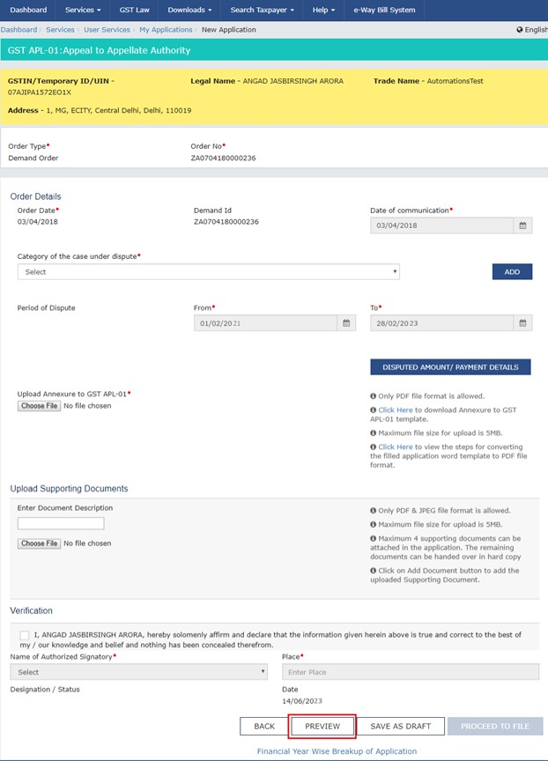
G. Preview the Application and Proceed to File
40. To preview the Application before filing, Click the PREVIEW button.

Slide 46
41. The PDF file will be downloaded. Open the pdf file and check if all the details are correctly updated.

Slide 47
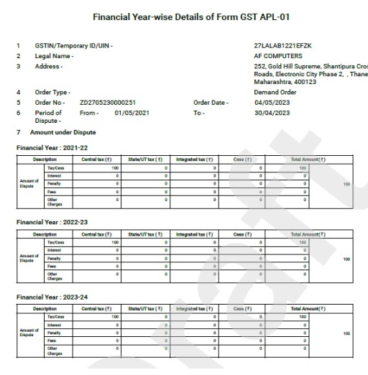
Note 1: Click the Financial Year Wise Breakup of Application to preview financial year wise breakup.
Note 2: The draft PDF with Financial Year Wise Breakup of amount disputed in the appeal application will be downloaded.

Slide 48
Note 3: Click the SAVE AS DRAFT button. The Saved details will be deleted if not submitted within 15 days from the date of saving the details.

Slide 49
42. Select the Name of the Authorized Signatory from the drop-down list. 43. Enter the Place where application is filled. 44. Click the PROCEED TO FILE button.

Slide 50
45. Click the PROCEED button. 46. Click the SUBMIT WITH DSC or SUBMIT WITH EVC button.

Slide 51
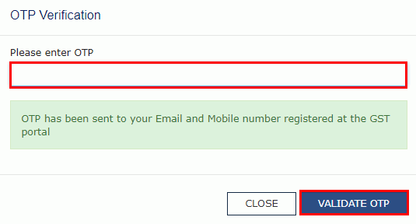
In case of SUBMIT WITH DSC a. Select the certificate and click the SIGN button. In case of SUBMIT WITH EVC a. Enter the OTP sent on email and mobile number of the Authorized Signatory registered at the GST Portal and click the VERIFY button.

Slide 52
47. A confirmation message is displayed that form has been signed. You can click the DOWNLOAD button to download the acknowledgement receipt. Once an appeal against a demand order is filed, an email and SMS is sent to the taxpayer (or an unregistered person, as the case may be) and Appellate Authority.

Slide 53
Practical Aspects - GOA
Grounds of Appeal to contain
The erroneous status of order
How the order has failed to consider the submissions
Violation of Principles of Natural Justice
Issue wise allegations and their responses
IF reasoned order, then Reasons given by the adjudicating authority for non acceptance of the plea
If Unreasoned order – Challenge the same
Quote the applicability or provision / circular / notification / GST Council minutes
Interpret how the provisions are either applicable / not applicable.
Defend all the allegation / reasoning given in the SCN and the order
Quote identical judicial pronouncements

Slide 54
Practical Aspects - SOF
Statement of Facts to contain
Who is the taxpayer
What is his GST Registration number if registered / Temp No.
Under which jurisdiction does the taxpayer fall?
When was the audit conducted (if applicable)
When was the response submitted
When was the SCN Issued
What were the allegations in the SCN
When and what was the response submitted for the SCN (brief)
When was the personal hearing called for and when did the appellant / AR Appear
When did the order was passed
When the order was received.

Slide 55
Practical Aspects – Physical Submissions
Where to submit
State Department
Central Department
How many copies
What is the documentation
What about certified copy of the order
Enclosures
Annexures
Obtaining Acknowledgement
APL-02
Delivery Note
NO Ack!!!

Slide 56
H. Withdraw an Appeal Application
1. to withdraw an appeal application, navigate to services > user services > my applications.

Slide 57
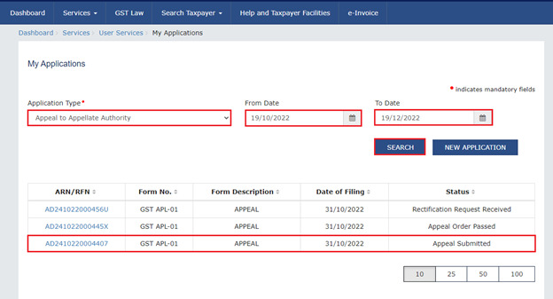
2. Select Appeal to Appellate Authority option from drop-down. Select period for which you wish to view applications from by clicking on calendar icon in From Date and To Date fields. 3. Click the SEARCH button. Search Results will be displayed, you can click the ARN hyperlink of the appeal you wish to withdraw.

Slide 58
4. From Case details page navigate to the Withdrawal Application tab.

Slide 59
5. Click on APPLY FOR WITHDRAWAL and then select Application for Withdrawal.

Slide 60
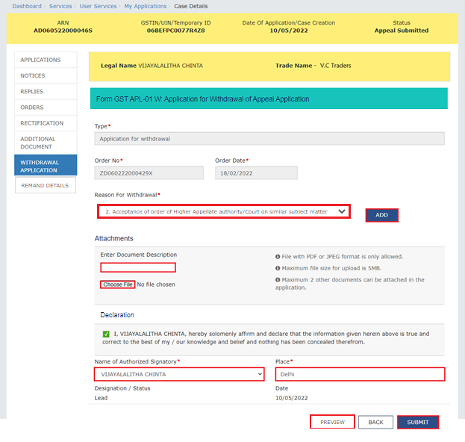
6. Select the Reason for withdrawal and click the Add button. Multiple reasons can be added by selecting from the drop-down. Upload the necessary documents and enter/select the Declaration details. Click the Submit button.

Slide 61
Note: You can select the appropriate reason from the following list of reasons of the Reason for Withdrawal drop-down.

Slide 62
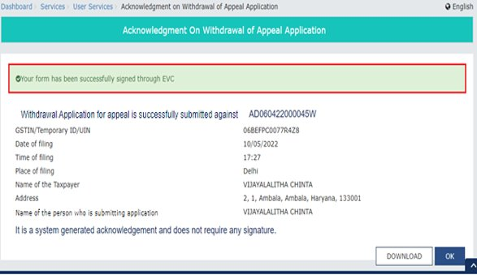
Note: Click on the PREVIEW button to view and download the PDF of Application for Withdrawal of Appeal Application before submitting the application.
7. Sign the application with DSC or EVC. After the application has been submitted, a success message will be displayed

Slide 63
I. Re-file an Appeal Application After Rejection or Withdrawal
If an appeal application has been rejected by the tax officer at admission stage or has been withdrawn, the taxpayer can file the application again using the same Order ID. To file the appeal again, follow the below steps:

Slide 64
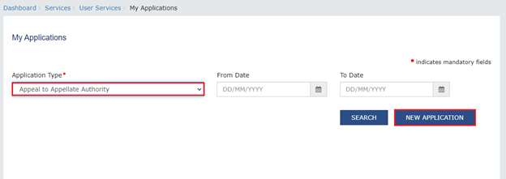
1. Navigate to My Applications under User Services and select the Application Type as Appeal to Appellate Authority. Click the New Application button.

Slide 65
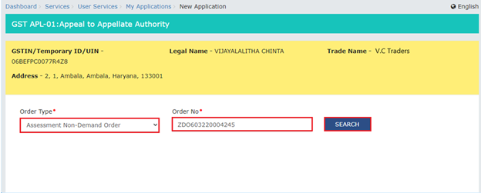
2. Select the Order Type and enter the Order number.

Slide 66
3. The Appeal to Appellate Authority form will be displayed. Select the Category of case under dispute and upload the necessary documents Enter the Verification details and click the Proceed to File button.

Slide 67
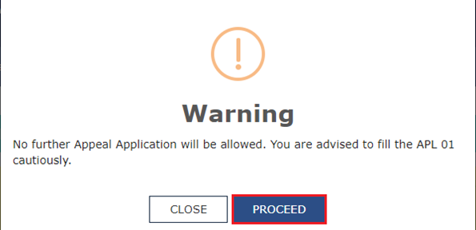
4. A Warning message will be displayed. The Appeal application cannot be filed again after this. To file the Appeal application, click the Proceed button. Submit the Application using DSC and EVC.

Slide 68
5. On successful submission of the application, the Provisional acknowledgement details will be displayed.

Slide 69
Final Points
Office Documentation
Engagement Agreement / Mail
Fee Confirmation
Collection of Advance
Billing of Balance

Slide 70
Thank You
SIRC of ICAI
GST & IDTC Committee All Participants Entire Technical Team
Please share your views about this session on
bharat@ssaca.in / +91 9362 303 406
CA. N K Bharath Kumar

